Slide 1
C PROGRAMMING

Slide 2
C Development Environment
Program is
created using the
Editor and
stored on Disk.
Phase 1 :
Editor
Disk
Preprocessor
program
processes the
code.
Phase 2 :
Preprocessor
Disk
Compiler
creates object
code and stores
it on Disk.
Phase 3 :
Compiler
Disk
Phase 4 :
Linker
Linker links object
code with libraries,
creates a.out and
stores it on Disk
Disk

Slide 3
C Development Environment cont
Primary
Memory
Phase 5 :
Loader
Loader puts
Program in
Memory
:
.
Primary
Memory
Phase 6 :
C P U (execute)
CPU takes each
instruction and
executes it, storing
new data values as
the program executes.
:
.

Slide 4
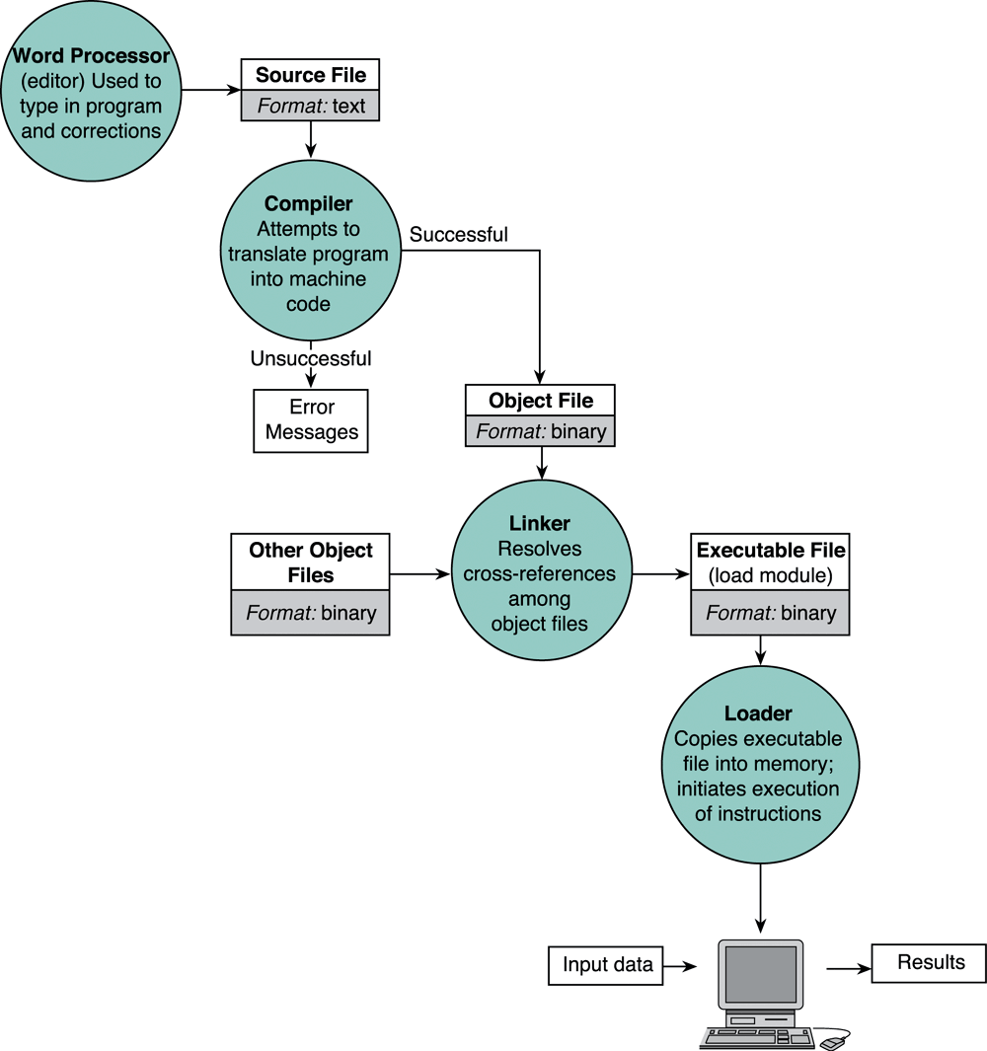
Entering, translating, and running a High-Level Language Program

Slide 5
Preprocessor directives
a C program line begins with # provides an instruction to the C preprocessor
It is executed before the actual compilation is done.
Two most common directives :
#include
#define
In our example (#include<stdio.h>) identifies the header file for standard input and output needed by the printf().

Slide 6
Function main
Identify the start of the program
Every C program has a main ( )
'main' is a C keyword. We must not use it for any other variable.
4 common ways of main declaration
int main(void)
{
return 0;
}
void main(void)
{
}
main(void)
{
}
main( )
{
}

Slide 7
The curly braces { }
Identify a segment / body of a program
The start and end of a function
The start and end of the selection or repetition block.
Since the opening brace indicates the start of a segment with the closing brace indicating the end of a segment, there must be just as many opening braces as closing braces (this is a common mistake of beginners)

Slide 8
Statement
A specification of an action to be taken by the computer as the program executes.
Each statement in C needs to be terminated with semicolon (;)
Example:
#include <stdio.h>
void main(void)
{
printf(“I love programming\n”);
printf(“You will love it too ”);
printf(“you know the trick\n”);
}
statement
statement
statement

Slide 9
Statement cont…
Statement has two parts :
Declaration
The part of the program that tells the compiler the names of memory cells in a program
Executable statements
Program lines that are converted to machine language instructions and executed by the computer

Slide 10
C program skeleton
In short, the basic skeleton of a C program looks like this:
#include <stdio.h>
void main(void)
{
statement(s);
}
Preprocessor directives
Function main
Start of segment
End of segment

Slide 11
Identifiers
Words used to represent certain program entities (variables, function names, etc).
Example:
int my_name;
my_name is an identifier used as a program variable
void CalculateTotal(int value)
CalculateTotal is an identifier used as a function name

Slide 12
Rules for naming identifiers
Rules | Example
Can contain a mix of characters and numbers. However it cannot start with a number | H2o
First character must be a letter or underscore | Number1; _area
Can be of mixed cases including underscore character | XsquAre my_num
Cannot contain any arithmetic operators | R*S+T
… or any other punctuation marks… | #@x%!!
Cannot be a C keyword/reserved word | struct; printf;
Cannot contain a space | My height
… identifiers are case sensitive | Tax != tax

Slide 13
Variables
Variable → a name associated with a memory cell whose value can change
Variable Declaration and definition: specifies the type of a variable
Example: int num;
Variable Intialiazation: assigning a value to the declared variable
Example: num = 5;

Slide 14
Basic Data Types
There are 4 basic data types :
int
float
double
char
int
used to declare numeric program variables of integer type
whole numbers, positive and negative
keyword: int
int number;
number = 12;

Slide 15
Basic Data Types cont…
float
fractional parts, positive and negative
keyword: float
float height;
height = 1.72;
double
used to declare floating point variable of higher precision or higher range of numbers
exponential numbers, positive and negative
keyword: double
double valuebig;
valuebig = 12E-3;

Slide 16
Basic Data Types cont…
char
equivalent to ‘letters’ in English language
Example of characters:
Numeric digits: 0 - 9
Lowercase/uppercase letters: a - z and A - Z
Space (blank)
Special characters: , . ; ? “ / ( ) [ ] { } * & % ^ < > etc
single character
keyword: char
char my_letter;
my_letter = 'U';
In addition, there are void, short, long, etc.
The declared character must be enclosed within a single quote!

Slide 17
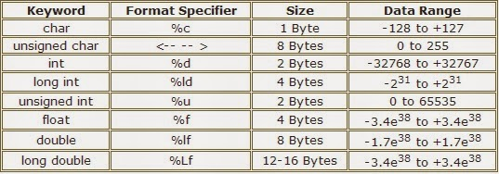

Slide 18
Constants
Entities that appear in the program code as fixed values.
Any attempt to modify a CONSTANT will result in error.
4 types of constants:
Integer constants
Positive or negative whole numbers with no fractional part
Example:
const int MAX_NUM = 10;
const int MIN_NUM = -90;
Floating-point constants (float or double)
Positive or negative decimal numbers with an integer part, a decimal point and a fractional part
Example:
const double VAL = 0.5877e2; (stands for 0.5877 x 10²)

Slide 19
Constants cont…
Character constants
A character enclosed in a single quotation mark
Example:
const char letter = ‘n’;
const char number = ‘1’;
printf(“%c”, ‘S’);
Output would be: S
Enumeration
Values are given as a list
Example:
enum Language {
Malay,
English,
Arabic
};

Slide 20
Constant example – volume of a cone
#include <stdio.h>
void main(void)
{
const double pi = 3.412;
double height, radius, base, volume;
printf(“Enter the height and radius of the cone:”);
scanf(“%lf %lf”,&height, &radius);
base = pi * radius * radius;
volume = (1.0/3.0) * base * height;
printf(“\nThe volume of a cone is %f ”, volume);
}

Slide 21
#define
You may also associate constant using #define preprocessor directive
#include <stdio.h>
#define pi 3.412
void main(void)
{
double height, radius, base, volume;
printf(“Enter the height and radius of the cone:”);
scanf(“%lf %lf”,&height,&radius);
base = pi * radius * radius;
volume = (1.0/3.0) * base * height;
printf(“\nThe volume of a cone is %f ”, volume);
}

Slide 22
Input/Output Operations
Input operation
an instruction that copies data from an input device into memory
Output operation
an instruction that displays information stored in memory to the output devices (such as the monitor screen)

Slide 23
Input/Output Functions
A C function that performs an input or output operation
A few functions that are pre-defined in the header file stdio.h such as :
printf()
scanf()
getchar() & putchar()

Slide 24
The printf function
Used to send data to the standard output (usually the monitor) to be printed according to specific format.
General format:
printf(“string literal”);
A sequence of any number of characters surrounded by double quotation marks.
printf(“format string”, variables);
Format string is a combination of text, conversion specifier and escape sequence.

Slide 25
The printf function cont…
Example:
printf(“Thank you”);
printf (“Total sum is: %d\n”, sum);
%d is a placeholder (conversion specifier)
marks the display position for a type integer variable
\n is an escape sequence
moves the cursor to the new line

Slide 26
Escape Sequence

Slide 27
Placeholder / Conversion Specifier

Slide 28
The scanf function
Read data from the standard input device (usually keyboard) and store it in a variable.
General format:
scanf(“Format string”, &variable);
Notice ampersand (&) operator :
C address of operator
it passes the address of the variable instead of the variable itself
tells the scanf() where to find the variable to store the new value

Slide 29
The scanf function cont…
Example :
int age;
printf(“Enter your age: “);
scanf(“%d”, &age);
Common Conversion Identifier used in printf and scanf functions.
 | printf | scanf
int | %d | %d
float | %f | %f
double | %f | %lf
char | %c | %c
string | %s | %s

Slide 30
The scanf function cont…
If you want the user to enter more than one value, you serialise the inputs.
Example:
float height, weight;
printf(“Please enter your height and weight:”);
scanf(“%f%f”, &height, &weight);

Slide 31
getchar() and putchar()
getchar() - read a character from standard input
putchar() - write a character to standard output
Example:
#include <stdio.h>
void main(void)
{
char my_char;
printf(“Please type a character: ”);
my_char = getchar();
printf(“\nYou have typed this character: ”);
putchar(my_char);
}

Slide 32
getchar() and putchar() cont
Alternatively, you can write the previous code using normal scanf and %c placeholder.
Example
#include <stdio.h>
void main(void)
{
char my_char;
printf(“Please type a character: ”);
scanf(“%c”,&my_char);
printf(“\nYou have typed this character: %c ”, my_char);
}

Slide 33
Few notes on C program…
C is case-sensitive
Word, word, WorD, WORD, WOrD, worD, etc are all different variables / expressions
Eg. sum = 23 + 7
What is the value of Sum after this addition ?
Comments (remember 'Documentation'; Chapter 2)
are inserted into the code using /* to start and */ to end a comment
Some compiler support comments starting with ‘//’
Provides supplementary information but is ignored by the preprocessor and compiler
/* This is a comment */
// This program was written by Hanly Koffman

Slide 34
Few notes on C program cont…
Reserved Words
Keywords that identify language entities such as statements, data types, language attributes, etc.
Have special meaning to the compiler, cannot be used as identifiers (variable, function name) in our program.
Should be typed in lowercase.
Example: const, double, int, main, void,printf, while, for, else (etc..)

Slide 35
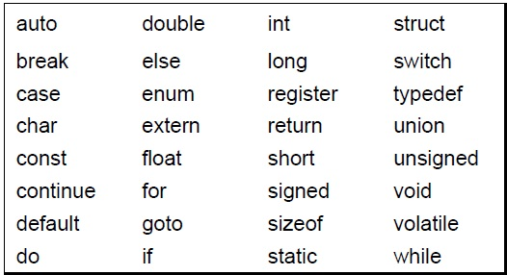
RESERVED KEYWORDS

Slide 36
Operators
An operator is a symbol that tells the computer to perform certain manipulations.
An expression is a sequence of operands and operators that reduces to a single value.
C operators can be classified into a number of categories.
Arithmetic operators
Relational operators
Logical operators
Assignment operators
Increment and decrement operators
Conditional operators
Bitwise operators
Special operators

Slide 37
Arithmetic operators
The arithmetic operators in C
Operator | meaning
+ | Addition or unary plus
- | Subtraction or unary minus
* | Multiplication
/ | Division
% | modulo division

Slide 38
Arithmetic operators
Note:,
Integer division truncates remainder
The % operator cannot be applied to a float or double.
The precedence of arithmetic operators
Unary + or -
* / %
+ -
Notes:
注意：
整数除法舍去余数；
%运算符只能用于整数
算术运算符的优先级

Slide 39
Arithmetic expressions
An arithmetic expression is a combination of variables, constants, and operators.
For example,
a*b-c → a*b-c
(m+n)(x+y) → (m+n)*(x+y)
ax²+bx+c → a*x*x+b*x+c

Slide 40
Shortcut Assignment Operators
Operator Example Equivalent
+= i+=8 i = i+8
-= f-=8.0 f = f-8.0
*= i*=8 i = i*8
/= i/=8 i = i/8
%= i%=8 i = i%8

Slide 41
Relational Operators
The relational operators in C are :
Operator | Meaning
< | less that
<= | less than or equal to
> | greater than
>= | greater than or equal to
== | equal to
!= | not equal to

Slide 42
Relational Operators
A relational expression yields a value of 1 or 0.
5 < 6 1
-34 + 8 > 23 - 5 0
if a=3, b=2, c =1; then a > b > c is ?
the associativity of relational operators is left → right
Notes:
关系表达式的结果为1或0
注意计算关系表达式的值与判断关系表达式值的真假在表示上的差别
计算时，若关系成立，结果为1，否则结果为0；
判断关系表达式值的真假时，只要表达式的值为非0，就表示关系成立；为0则表示关系不成立。
经常采用简化写法，如n%2!=0可写为n%2
关系运算符的结合型：左-〉右

Slide 43
Bitwise operators
Operator | Meaning
& | Bitwise AND
| | Bitwise OR
^ | Bitwise Exclusive
<< | Shift left
>> | Shift right

Slide 44
Result of logical Bitwise Operation
op1 | op2 | op1&op2 | op1|op2 | op1^op2
1 | 1 | 1 | 1 | 0
1 | 0 | 0 | 1 | 1
0 | 1 | 0 | 1 | 1
0 | 0 | 0 | 0 | 0

Slide 45
Example
Bitwise AND
x - - -> 0000 0000 0000 1101
y - - -> 0000 0000 0001 1001
x&y- - -> 0000 0000 0000 1001
Bitwise OR
x - - - > 0000 0000 0000 1101
y - - -> 0000 0000 0000 1001
x|y - - -> 0000 0000 0001 1101

Slide 46
Bitwise Exclusive OR
x - - -> 0000 0000 0000 1101
y - - -> 0000 0000 0001 1001
x^y - - -> 0000 0000 0001 0100

Slide 47
Bitwise shift operators
Left shift
op<<n
Eg. 0100 1001 1100 1011
x<<3 0100 1110 0000
Right shift
op>>n

Slide 48
Bitwise Complement Operators
~ one’s complement operator is a unary operator.

Slide 49
Logical operators
Operator | Meaning
&& | Logical AND
|| | Logical OR
! | Logical NOT

Slide 50
Examples
Logical AND (&&) a > b && x = = 10
Logical OR (||) a < m || a < n
Logical NOT (!)
! (x >= y)

Slide 51
Assignment Operators
In addition, C has a set of shorthand assignment operators of the form. var oper = exp; Example x = a + b

Slide 52
Increment and Decrement
syntax:
1. ++variable name 2. variable name++ 3. – –variable name 4. variable name– – x= 5; y = ++x; (prefix) In this case the value of y and x would be 6
x= 5; y = x++; (post fix) Then the value of y will be 5 and that of x will be 6.

Slide 53
Special operators
Comma operator
Size of operator
Pointer operators (& and *)
Member selection operators (. and ->).

Slide 54
Comma operator
Link related expressions together
Expressions are evaluated left to right
for e.g.
value = (x = 10, y = 5, x + y);
for (n=1, m=10, n <=m; n++, m++)

Slide 55
The sizeof Operator
Gives size of bytes occupied in the memory.
To determine the lengths of arrays and structures when their sizes are not known to the programmer
for e.g.
x = sizeof (sum); y = sizeof (long int); z= sizeof (235L);

Slide 56
Precedence and Associativity
Precedence rules decides the order in which different operator are applied.
Associativity rule decides the order in which multiple occurrences of the same level operator are applied.

Slide 57
Summary of C operator
Description | Operator | Rank | Associativity
Function call Array element reference | ( ) [] | 1 | Left to right
Unary plus Unary minus Increment Decrement Logical negation Ones complement Address Size of an object | + - ++ -- ! ~ & Sizeof | 2 | Right to left
Multiplication Division Modulus | * / % | 3 | Left to right
Addition Subtraction | + - | 4 | Left to right
Left shift Right shift | << >> | 5 | Left to right
Less than Less than equal to Greater than Greater than equal to | < <= > >= | 6 | Left to right
Equality Inequality | = = |= | 7 | Left to right

Slide 58
Continue….
Bitwise AND | & | 8 | Left to right
Bitwise XOR | ^ | 9 | Left to right
Bitwise OR | | | 10 | Left to right
Logical AND | && | 11 | Left to right
Logical OR | || | 12 | Left to right
Conditional operator | ?: | 13 | Right to left
Assignment operator | = *=/=%= +=-=&= ^=|= << = >>= | 14 | Right to left
Commas operator | , | 15 | Left to right

Slide 59
Assignment operators
The use of shorthand assignment operators has three advantages:
1. What appears on the left-hand side need not be repeated and therefore it becomes easier to write.
2. The statement is more concise and easier to read.
3. The statement is more efficient.
Notes:
使用复合的赋值运算符有三点好处：
容易书写
语句更简洁、易读
语句效率高

Slide 60
Increment and decrement operators
C provides two unusual operators for incrementing and decrementing variables.
The increment operator ++ adds 1 to its operand, while the decrement operator -- subtracts 1.
The unusual aspect is that ++ and -- may be used either as prefix operators (before the variable, as in ++n), or postfix operators (after the variable: n++).
In both cases, the effect is to increment n. But the expression ++n increments n before its value is used, while n++ increments n after its value has been used.
Notes:
自增自减运算符
自增自减运算符“前置”和“后置”的区别
“前置” 变量先增值(或先减值),后被引用
“后置” 变量先被引用,后再增值(或后减值)
两种情况下，变量的值都加1

Slide 61
The increment and decrement operators can be used in complex statements. Example:
m=n++ -j +10;
Consider the expression
m = - n++ ;
The precedence of ++ and – operators are the same as those of unary + and -.
The associatively of them is right to left.
m = - n++; is equivalent to m = - (n++)
Notes:
++和—的优先级同单目的+，- 相同，右结合

Slide 62
Conditional operator
a ternary operator pair “? : ” is available in C to construct conditional expressions of the form
expr1 ? expr2 : expr3
the expression expr1 is evaluated first. If it is non-zero (true), then the expression expr2 is evaluated, and that is the value of the conditional expression. Otherwise expr3 is evaluated, and that is the value. Only one of expr2 and expr3 is evaluated.
Notes:
条件运算符是C语言中唯一的三目运算符

Slide 63
Special operators
1. The Comma Operator
The comma operator can be used to link the related expressions together. A comma-linked list of expressions is evaluated left to right and the value of right-most expression is the value of the combined expression. For example, the statement
value = (x=10, y=5, x+y);
first assigns the value 10 to x, then assigns 5 to y, and finally assigns 15 to value. Since comma operator has the lowest precedence of all operators, the parentheses are necessary.
Notes:
逗号运算符的运算顺序是从左到右，表达式的值为最右端表达式的值
逗号运算符的优先级最低

Slide 64
Type Casting, cont.
Implicit casting
double d = 3; (type widening)
Explicit casting
int i = (int)3.0; (type narrowing)
What is wrong? int x = 5/2.0;

Slide 65
Explicit type conversions - casts
If you want to convert a value from a variable of one type to a variable of another type you can use a cast. For example, to convert an int into a float, you can use the following code:
int anInteger = 6;
float aFloat;
aFloat = (float)anInteger;
The general form is to give the target type in parentheses before the source variable.

Slide 66
Implicit type conversions
An implicit type conversion is a type conversion that is performed by the compiler. C had an extensive set of rules for implicit type conversion. Here is a simple example:
int i = 2;
float d = 1.32;
printf(“Result is %f”, d + i);
In the expression above, as in all arithmetical expressions, the target type becomes the largest type in the expression, thus the target type is float and the 2 is converted to 2.0. The result of the expression is 3.32.

